Slide 1
Graduation Project Presentation
Student:Ali Mohamed Reda Attiha
Track:Software Testing
Supervisor Name:George Nafady
Date of Presentation:28/10/2024

Slide 2
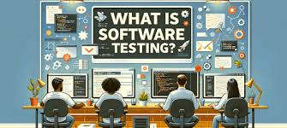

Slide 3
Software Testing
Definition: Software testing is the process of evaluating a software application to detect differences between existing and required conditions and ensure the software performs as expected.
Objective: Improve quality, security, and performance of software products.

Slide 4
Types of Software Testing
Functional Testing: Validates individual functions and overall functionality.
Non-Functional Testing: Focuses on performance, security, usability, and reliability.
Manual Testing: Test cases are executed manually without automation.
Automated Testing: Uses tools to execute test cases automatically, saving time.

Slide 5
Manual Testing vs. Automated Testing
Overview
Manual Testing: Test cases are executed manually by a tester, without the use of automation tools.
Automated Testing: Test cases are executed with the help of scripts and tools, reducing the need for human intervention

Slide 6
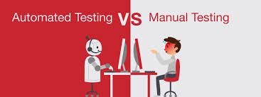

Slide 7
Aspect | Manual Testing | Automated Testing
Execution | Performed by humans, observing and interacting directly. | Performed by scripts, running tests automatically.
Speed | Slower, since tests are done manually step-by-step. | Much faster, ideal for repetitive tasks or large test cases.
Initial Cost | Low, minimal setup costs. | Higher initial investment due to tool costs and setup.
Human Intervention | Required for each test run. | Minimal intervention after setup.
Accuracy | Prone to human error. | Higher accuracy, as tests are consistent once coded.
Best for | Exploratory, usability, and ad-hoc testing. | Regression, load, and performance testing.
Test Coverage | Limited, as time and resources are factors. | Higher, as automated tests can run repeatedly on demand.
Maintenance | Easier to adapt on-the-fly. | Requires regular updates to scripts with app changes.
Examples of Tools | None required, but may use spreadsheets or test cases. | Selenium, JUnit, TestNG, Cypress, and others.

Slide 8
Why is Software Testing Important?
Ensures software reliability and security.
Helps prevent failures and defects in the final product.
Saves costs by identifying issues early.
Enhances User Satisfaction by providing reliable and smooth experience

Slide 9
Acknowledgments
Our heartfelt thanks to Eng George Nafady, whose guidance and belief in me made this project possible. Your support has meant a lot to me, and I’m deeply grateful for your mentorship

Slide 10

Thank You!

